Slide 1


Development of Virtual Line Crossing Detection on Surveillance Video System
YANGON TECHNOLOGICAL UNIVERSITY Department of Computer Engineering & Information Technology
Third Seminar
(26 -8-2020 )
Supervised By – Presented By-
Dr. Khine Thinzar Wine Myat Chal
ME CEIT-5

Slide 2
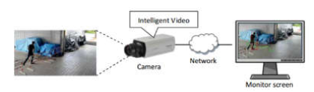
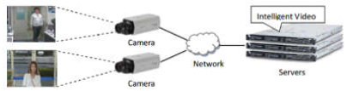
Introduction
The Intelligent Video Surveillance System is mainly composed with Artificial Intelligent (AI) based vision algorithms such as face detection and recognition, abnormal motion detection, cross line detection and etc.
These algorithms are installed on cameras or computing server.
Depending on algorithm installation, there are two types of AI video surveillance systems.
One is AI camera system and another is server computing system. AI camera system is not expensive but two AI algorithms are at most installed as built-in. these AI algorithms cannot be changed.
In the server computing system, many AI algorithms can be installed on server. It is very expensive and scalable.
AI camera based video surveillance system
Server based video surveillance system

Slide 3
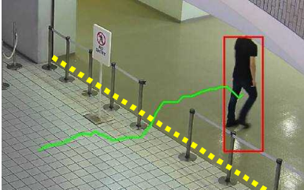
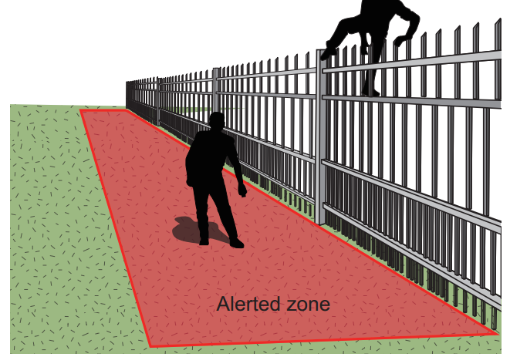
Introduction
Cross line detection is an important technique of the both AI based video surveillance systems.
Line Crossing Detection detects people or objects trespassing in restricted areas. When a network camera detects moving objects in its view, the camera starts tracking each one of them.
Once the object crosses an imaginary line in pre-defined direction, incoming, outgoing or either direction, the camera sends an alarm to the operators and highlights them with frame.
This helps the operator easily identify what crossed the line.
The cross line detection is usually developed in the form of commercial security applications.
The main challenges of the technique are object moving direction and tracking.

Slide 4
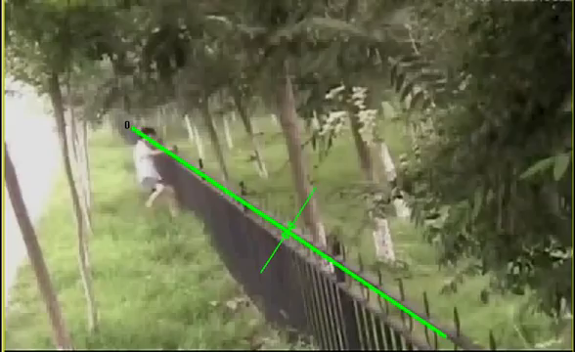
Challenges in Line Crossing Detection
The common problem is pre-defined fixed line which is the boundary between restricted and allowable area. It can be used for only the specific application area.
When we want to change the line in another place, how can we do?
At least, we have to configure this setting again.
https://www.youtube.com/watch?v=zGTXbxcH4TA

Slide 5
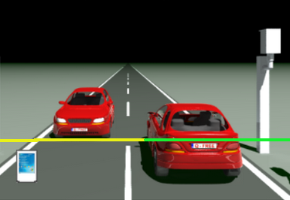
Challenges in Line Crossing Detection
Next is the position of camera and object.
In the figure, which car is crossing the line?
The car in right side is crossing the line.
The car in left side is not.
In really, the two car have not cross the line yet.
As the camera is behind the right side car, some portions of the car is overlap on the line, we think that the right side car has been crossed the line.
Actually, it has not been crossed yet.

Slide 6
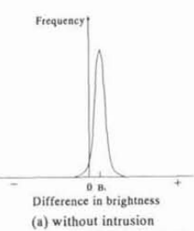
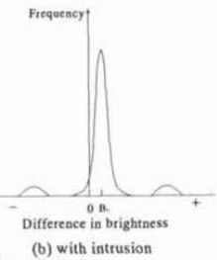
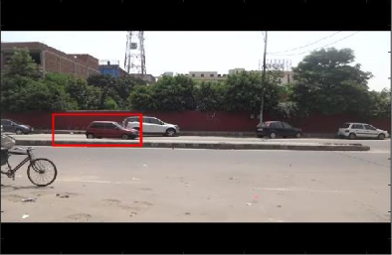
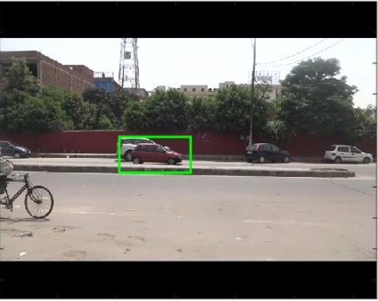
Existing Methods
Depending on brightness and histogram [3]
Depending on Size and Area of object overlapping [1], [2]
Note that these methods will be wrong in the condition of previous slide.

Slide 7
Proposed System Flow Diagram
Object (Human) Classification
Motion Object Detection using GMM
Input video
Frame segmentation
Blob Analysis
Start
Lower Corner Estimation
Input line or restricted region
Extraction of Line or Region from frame image
Comparison among object’s corner and Line or Regional area
Yes
If (centroid > line)
End
Activate alarm of Line Crossing
No

Slide 8
Completely Processes
Object (Human) Classification
Motion Object Detection using GMM
Input video
Frame segmentation
Blob Analysis
Start
Lower Corner Estimation
Input restricted region
Extraction of Region from frame image
Comparison among object’s corner and Regional area
Activate alarm and moving object is covered by boundary box
If (corner point is on area)
End
Yes
No

Slide 9
Research Methodology
Input Video Stream and Frame Segmentation
Input video is captured by fixed camera.
The resolution of the input video is 1,280 x 720 pixels and frame rate is 30 frame per second.
Object detection range is within 50 m.
In the next processes, frame per frame processing will be used so the input video stream is divided into frame images and converted them into grayscale image.

Slide 10
Research Methodology (Cont;)
Motion Object Detection by Gaussian Mixture Model
Gaussian Mixture Model is widely used for background subtraction because it is simple and fast.
Hence, to extract foreground moving objects from static background, the GMM is used.
The first 20 frame images are used for training of the GMM so the system cannot detect moving objects within the 2/3 second.

Slide 11
Research Methodology (Cont;)
Blob Analysis and Lower Corner Estimation
After the object classification, to generate the required properties (BoundingBox, Area, Centroid) of the moving object, Blob Analysis is applied.
After the Blob analysis, Area, Centroid and BoundingBox of the moving object are received.
Lower corner can be estimated by the following formula
Bbox(x, y, w, h)
Lowercorner(v,u)= (x,y+h)
Where, x,y is the initial point of boundingbox, w is width of bounding box and h is height of bounding box.

Slide 12
Research Methodology (Cont;)
Input Line or Restricted Area
On the input video stream, a line or a polygon (Restricted Region) is drawn.
After drawing this, the line or the polygon is mixed with capture video sense.

Slide 13
Research Methodology (Cont;)
Extraction of Line or Restricted Region
To determine moving object is whether passed through the line or not, mask layer image of the line or the polygon (Restricted Region) is necessary to extract from the frame image in individually.
To extract the line or the polygon, frame image with no line or polygon is subtracted from frame image with line or polygon.
The initial points of line is saved. (only for line cross detection).

Slide 14
Research Methodology (Cont;)
End of line
Comparison between object lower corner and line
Estimate base angle of line
Estimate base angle of object lower corner related to initial point of the line.
Compare the two angles
z
corner (u,v)
w
θ
β
initial
b
initial
b
θ = cos⁻¹ (b/z)
β = cos⁻¹ (b/w)
z = the distance between initial point of line and the intersection point of normal and line
b = the unit base
z = the distance between initial point of line and the intersection point of normal and corner line
w = angle between corner and unit base
θ = angle between line and unit base
If (β < θ ) , the moving object is passed over the line

Slide 15
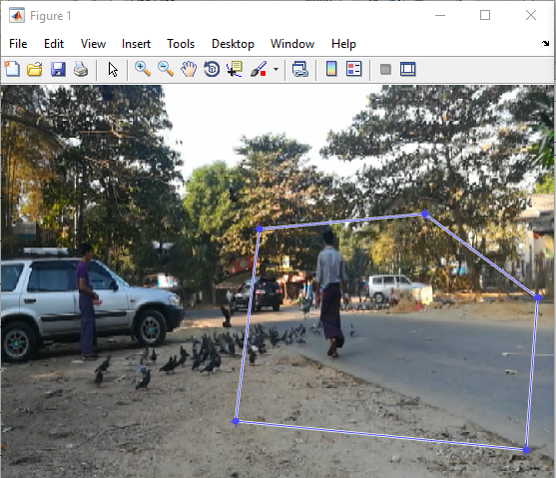
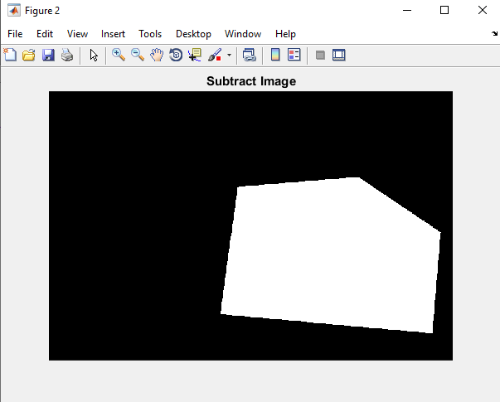
Research Methodology (Cont;)
Comparison between object centroid and Restricted Region
If (the pixel of mask image which is the same coordinate of centroid = = 1)
The moving object is inside of the restricted region
Else
The moving object is outside of the restricted region

Slide 16
Research Methodology (Cont;)
Activate Alarm of the entering regions
If moving object is inside of the restricted region, alarm is activated and the moving objected is covered with BoundingBox.

Slide 17
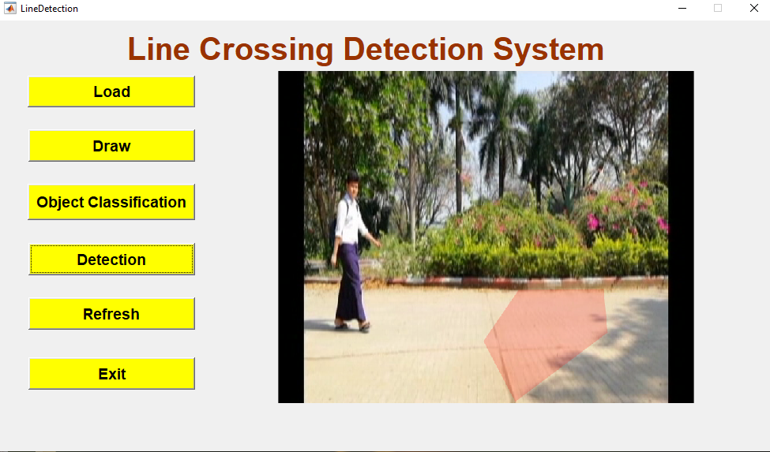
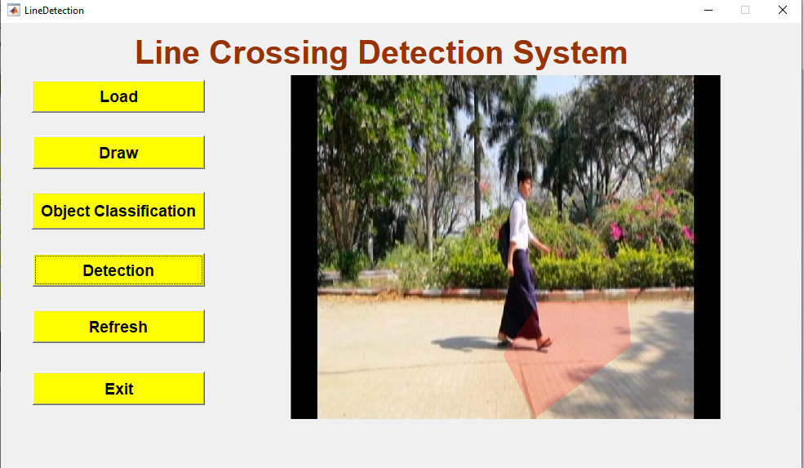
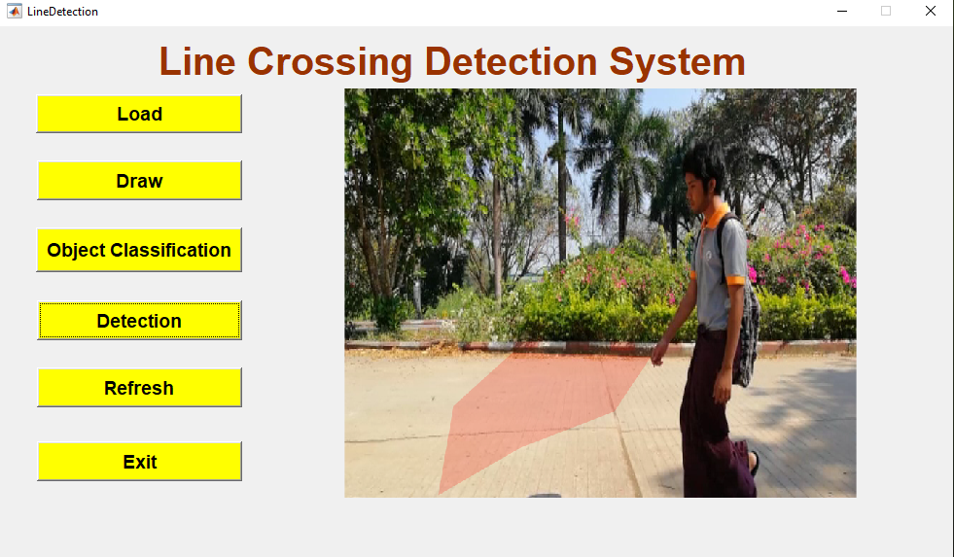
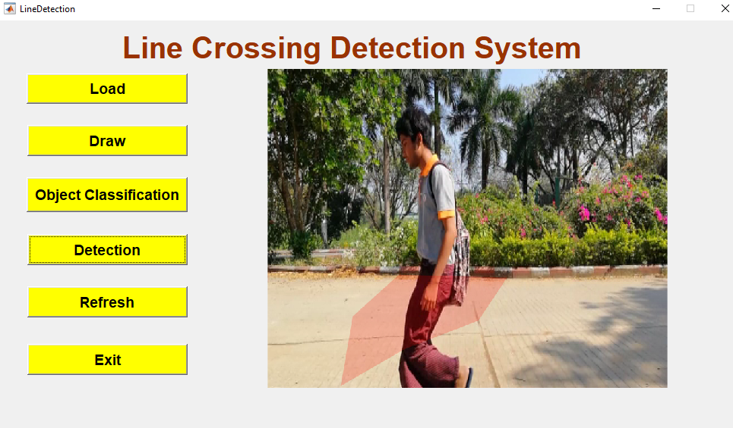
System Implementation
He has not enter the area but his body is overlap with the area.

Slide 18
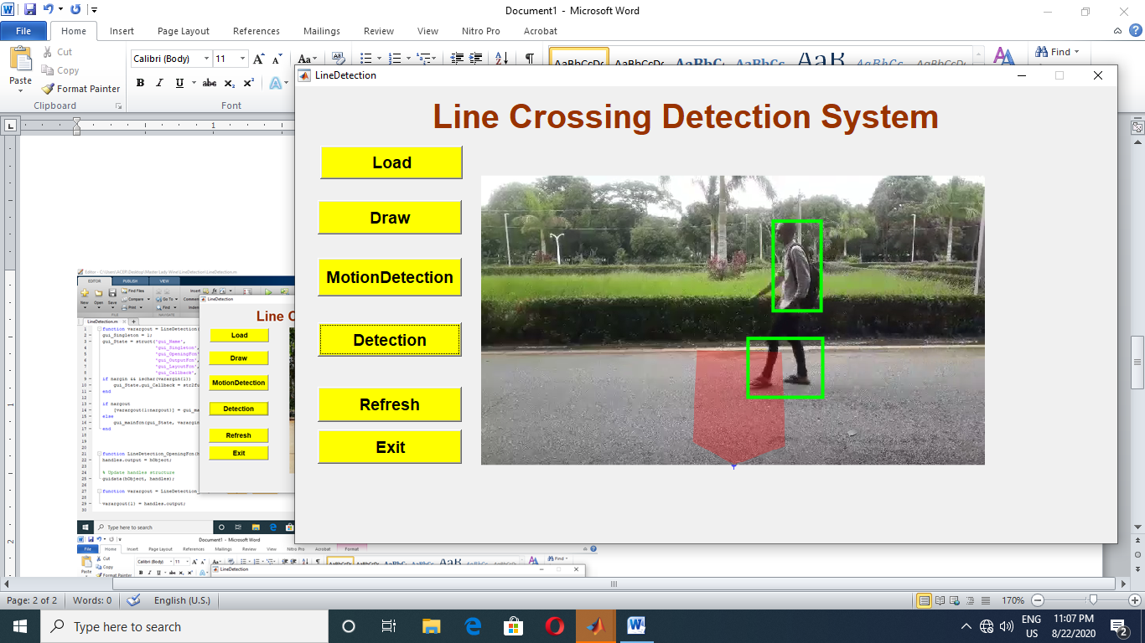
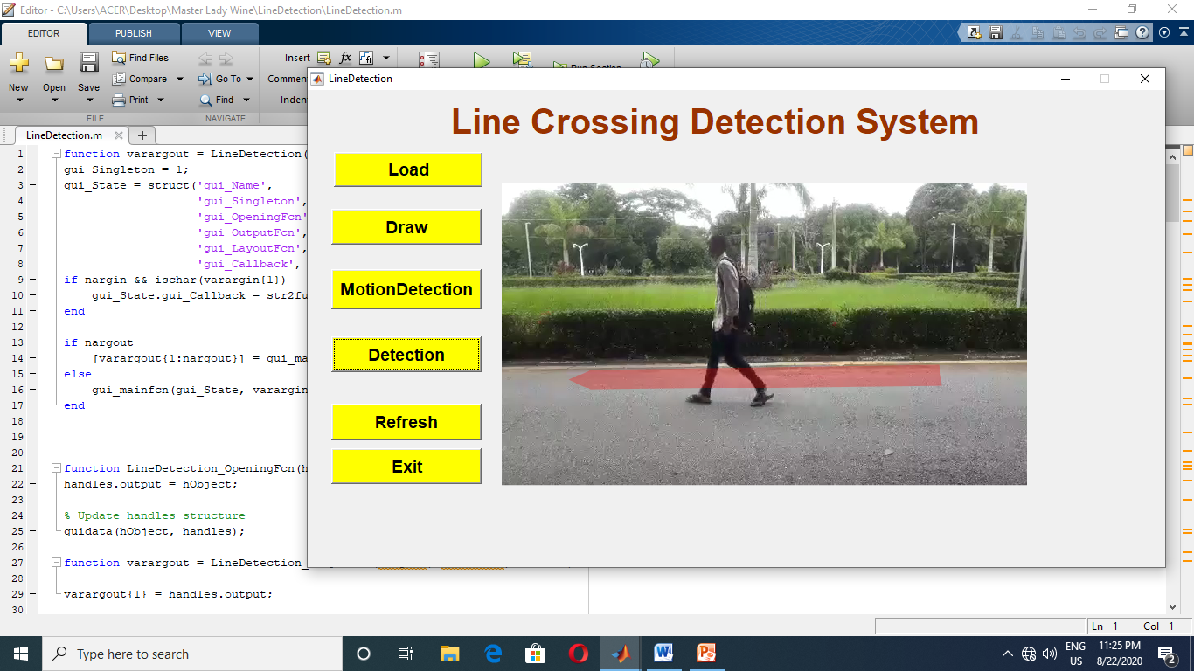
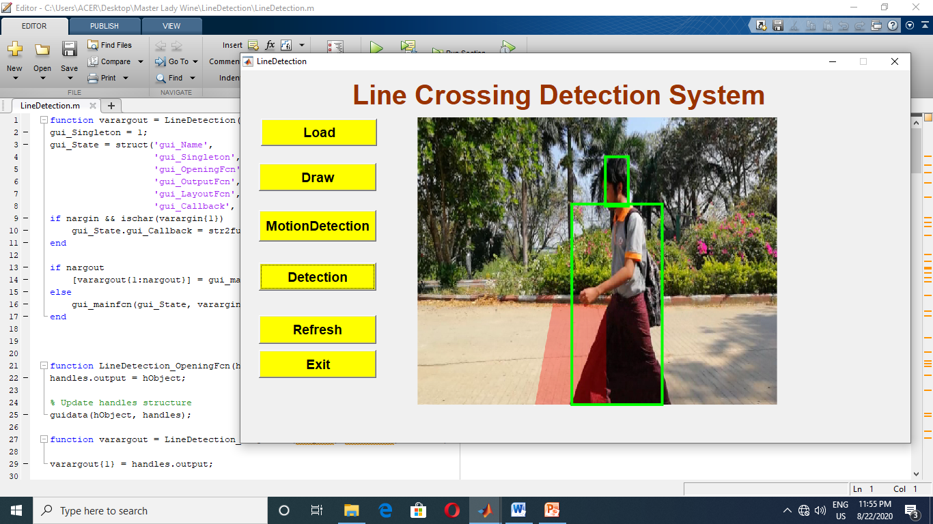
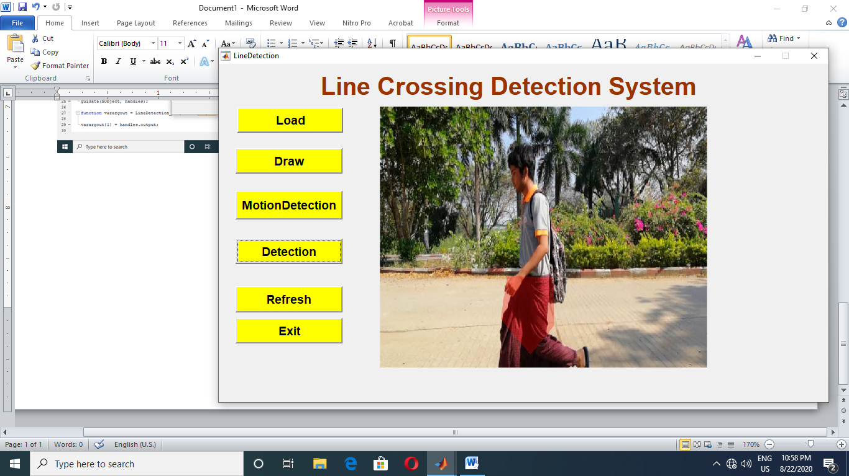
System Implementation (Cont;)
He has not enter the area but his body is overlap with the area.

Slide 19
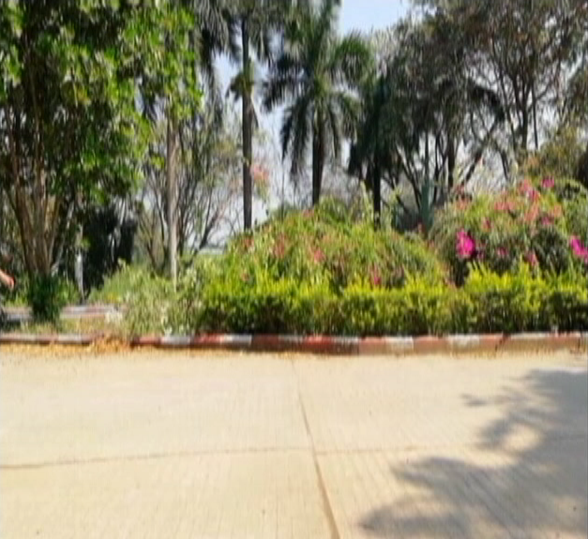

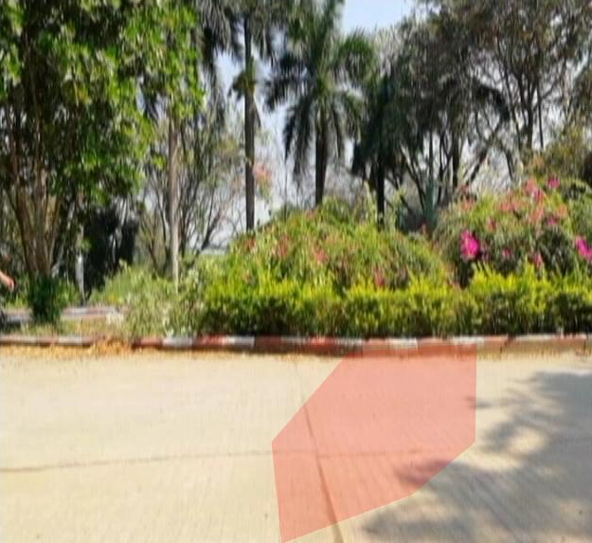

Experiment
(a) Initial frame image
(b) Polygon shape drown for restricted area
(c) Restricted area on frame image
(a)
(b)
(d) Restricted area on mask channel image
(c)
(d)

Slide 20
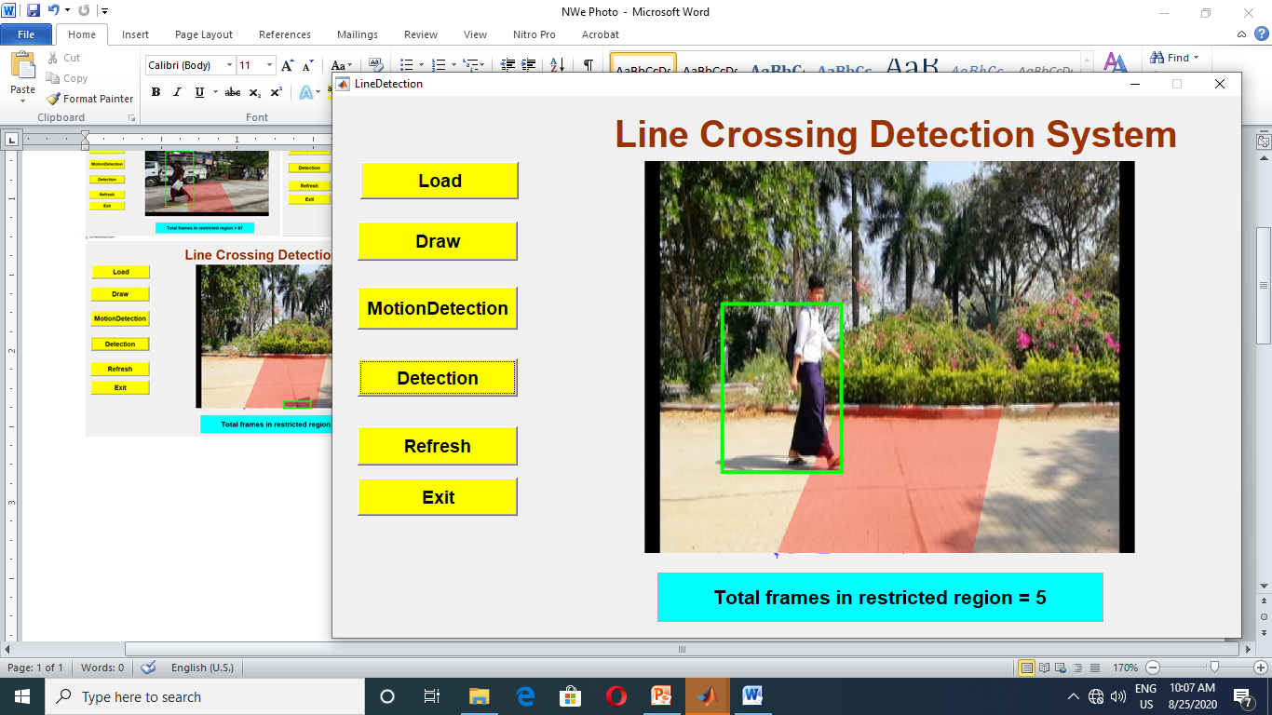
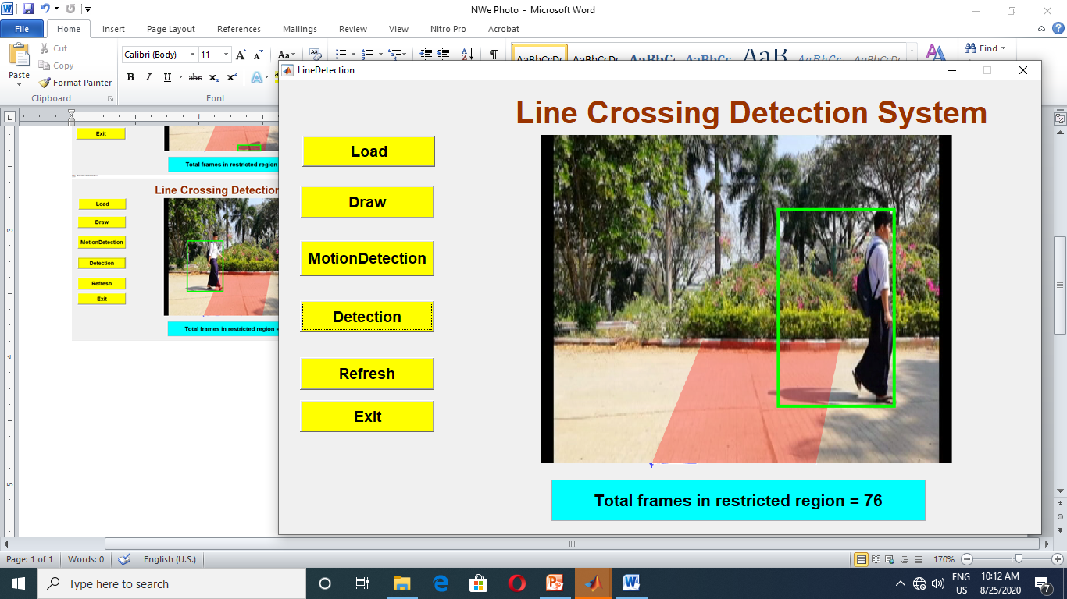
Experiment

Slide 21
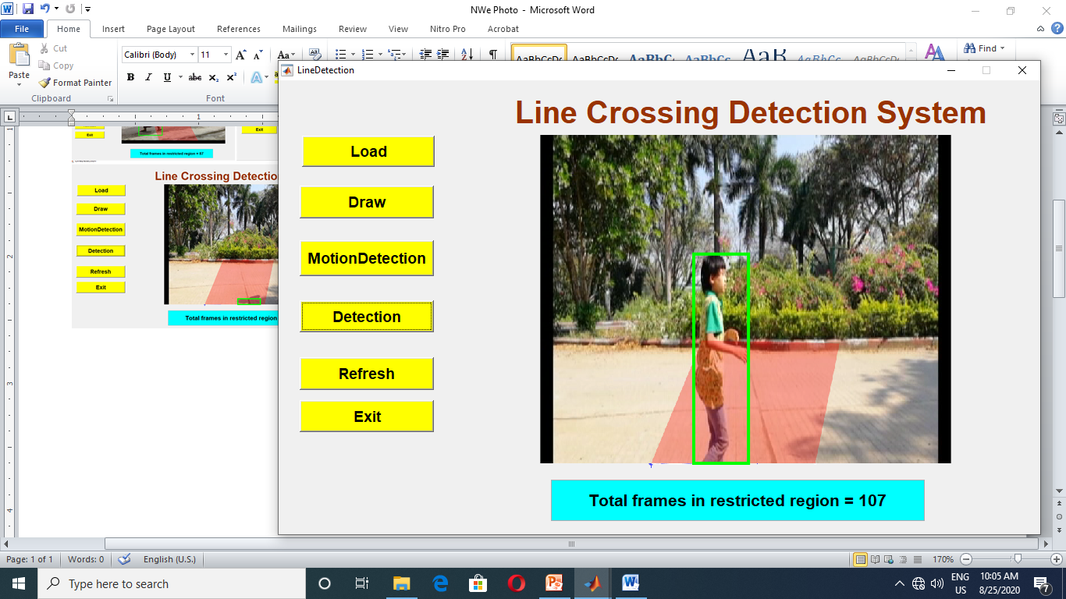
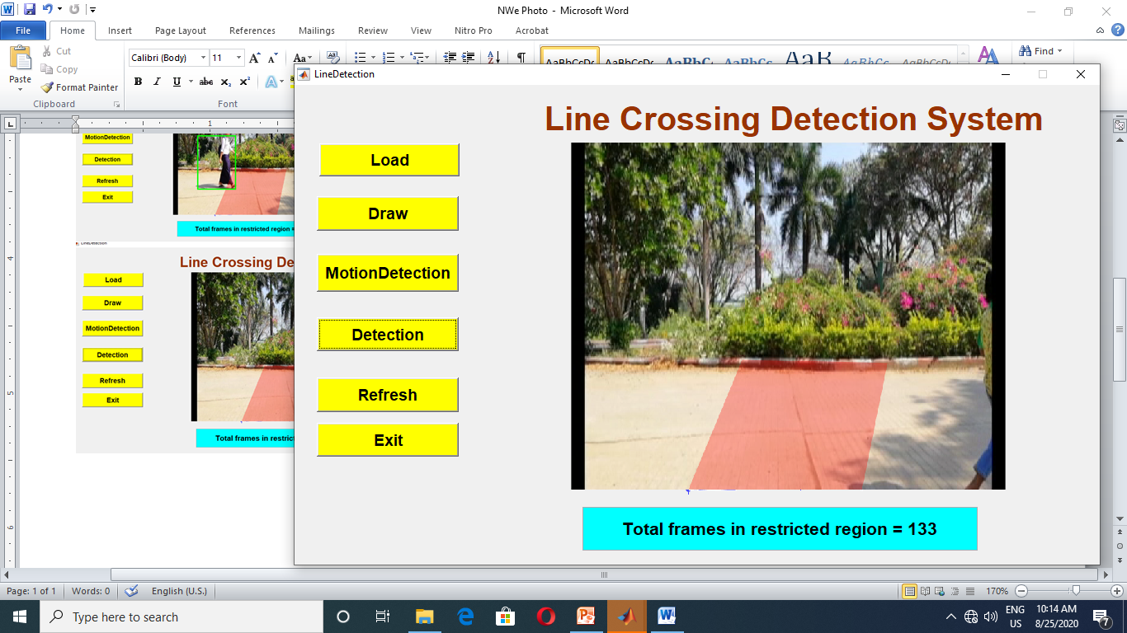
Experiment (Cont;)

Slide 22
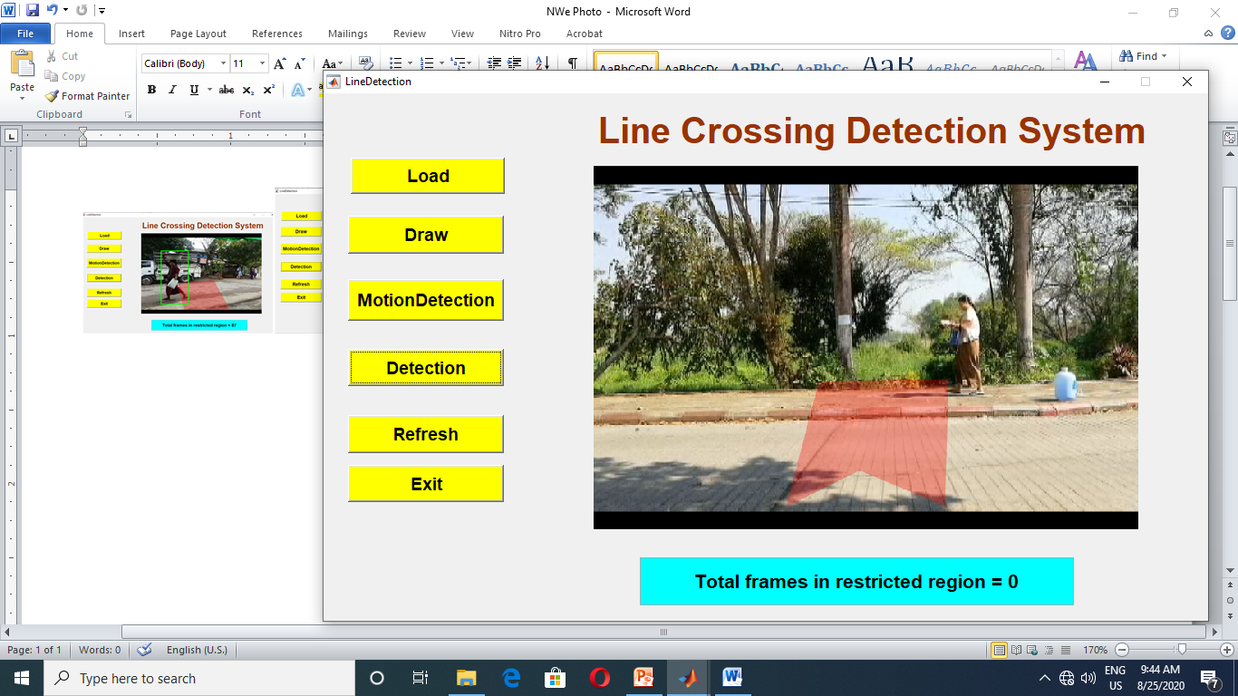
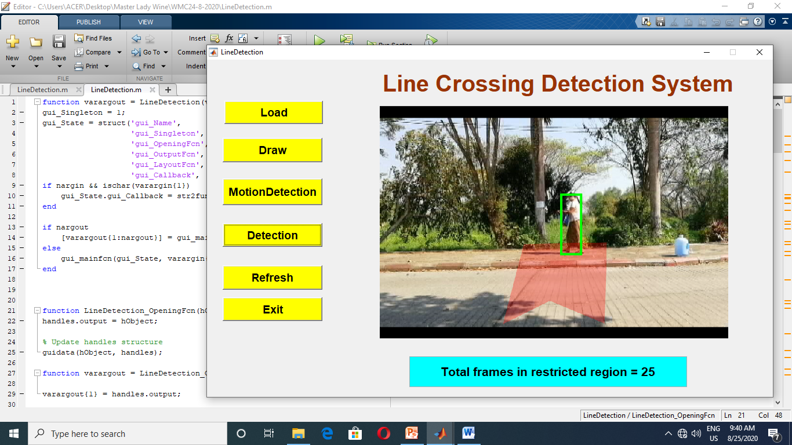
Experiment (Cont;)

Slide 23
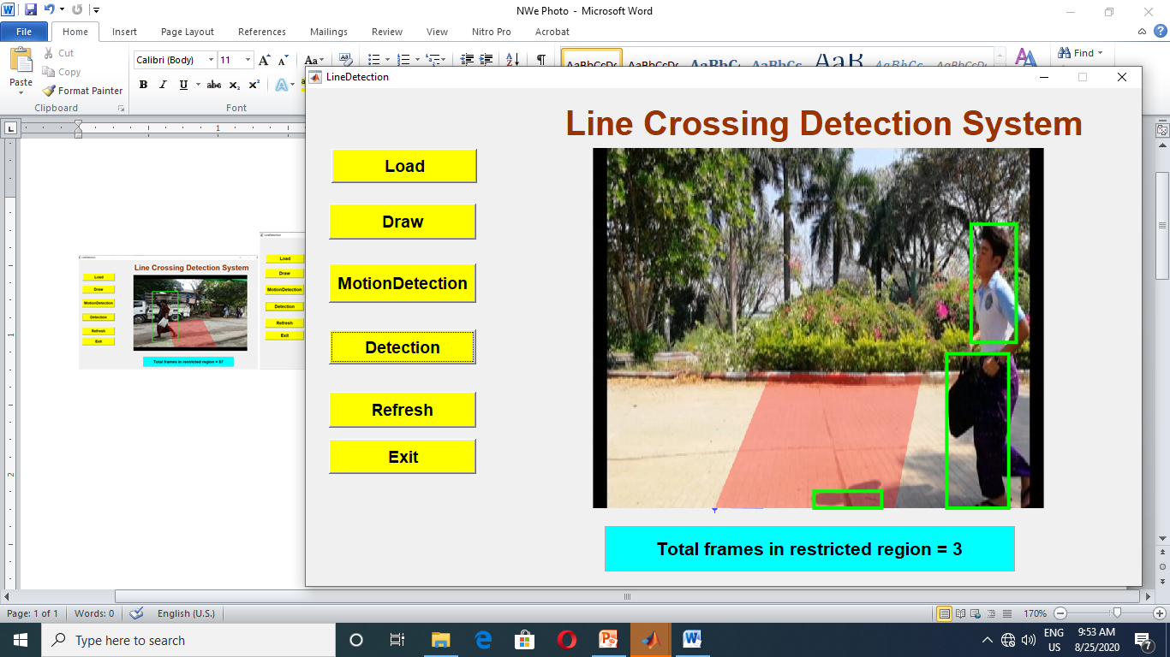
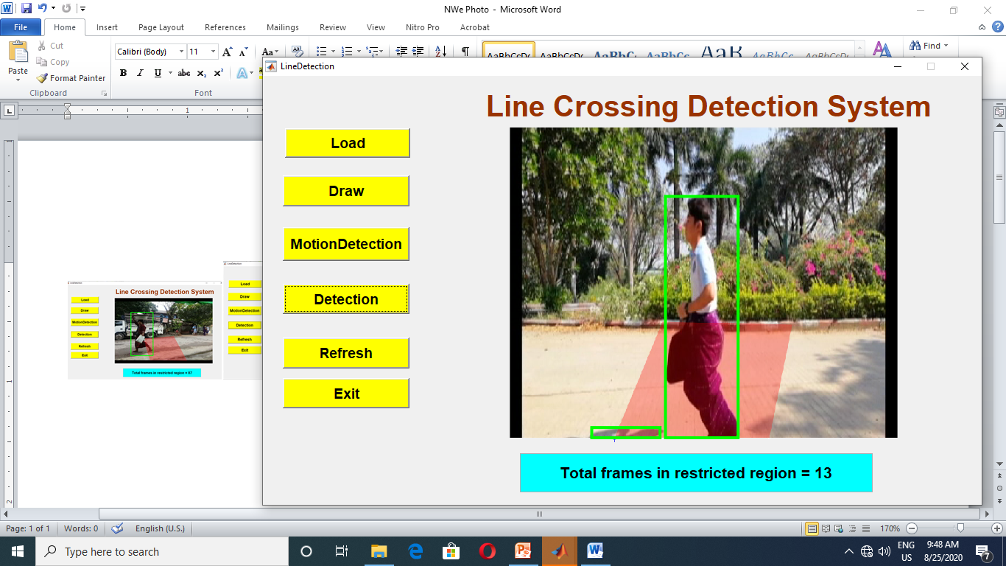
Experiment (Cont;)

Slide 24
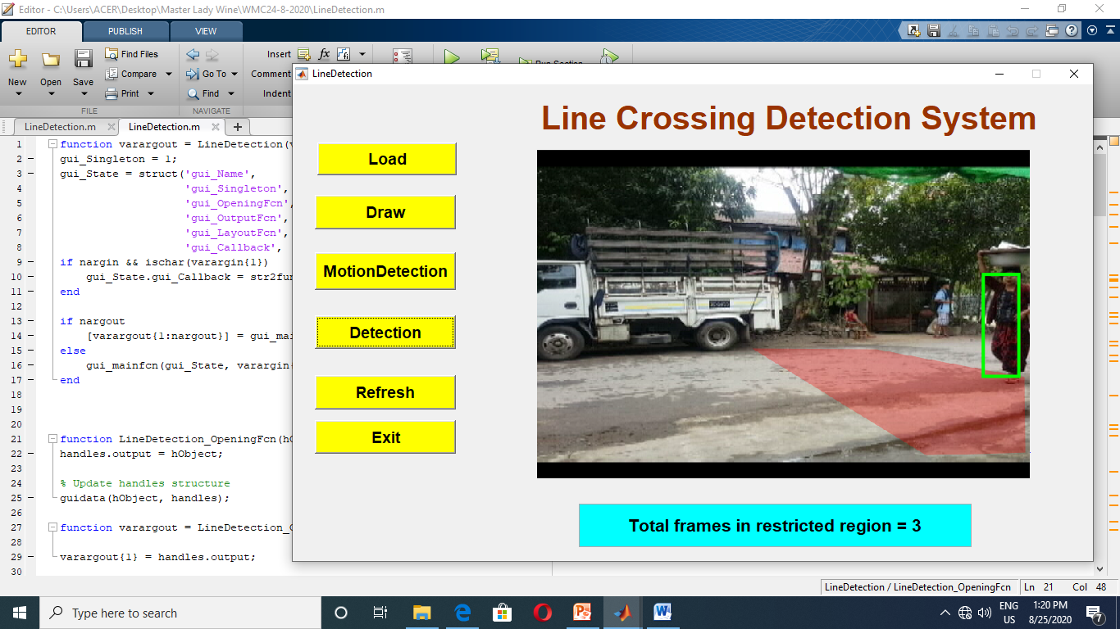
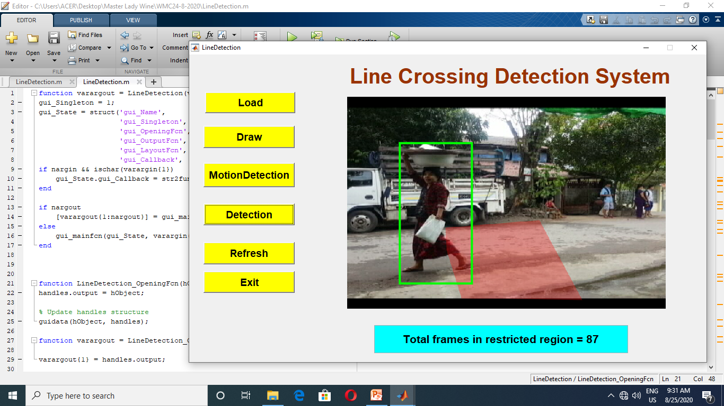
Experiment (Conts;)

Slide 25
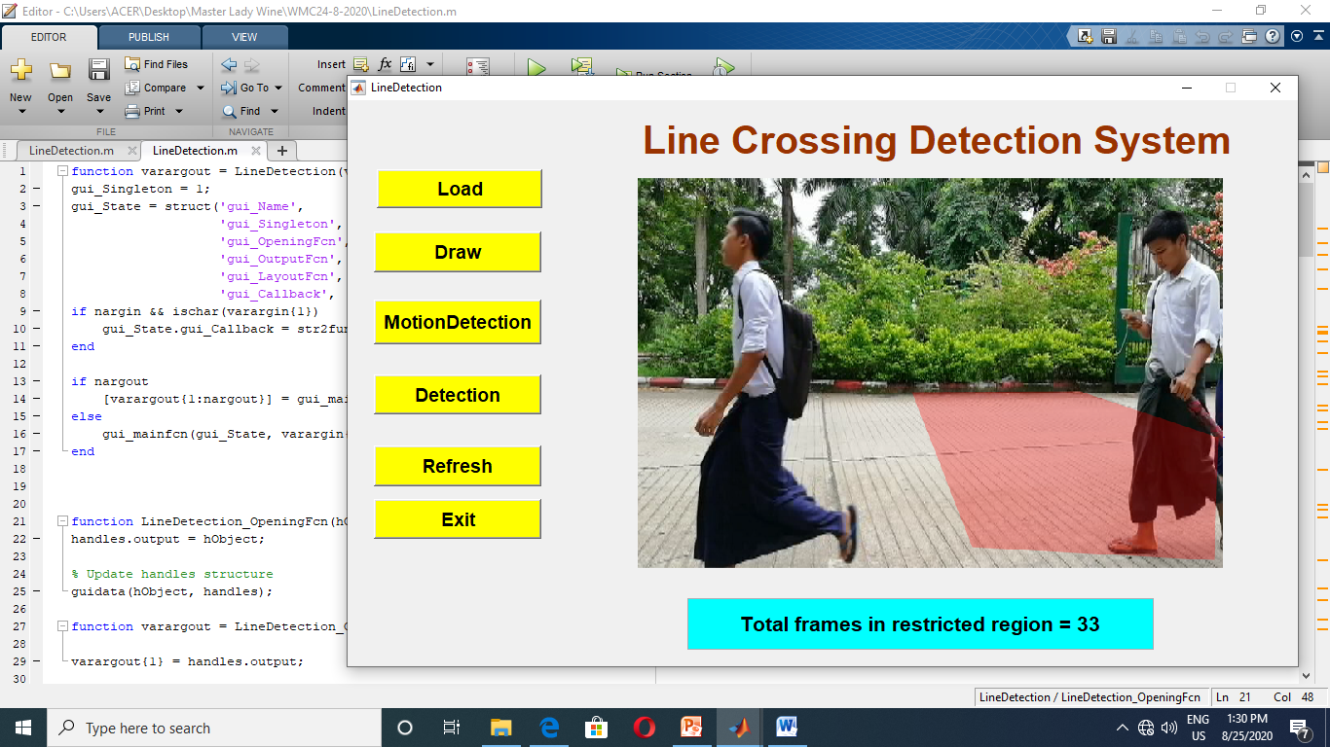
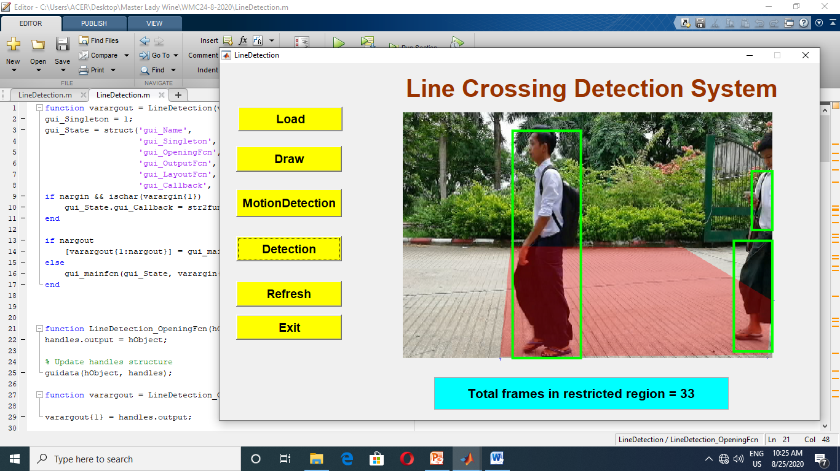
Experiment (Cont;)

Slide 26
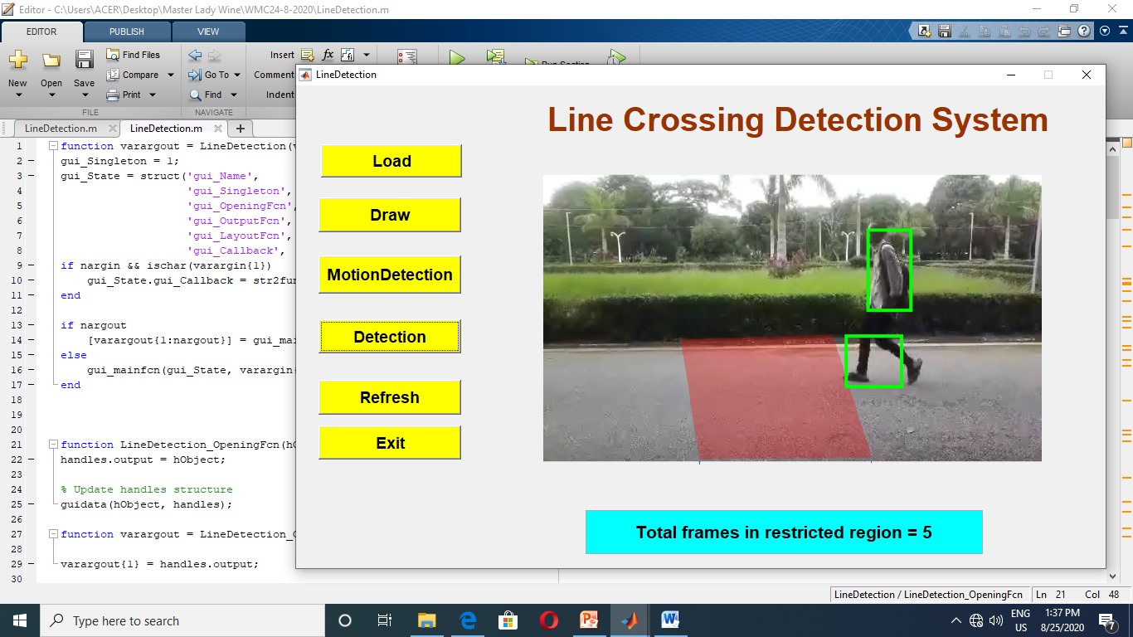
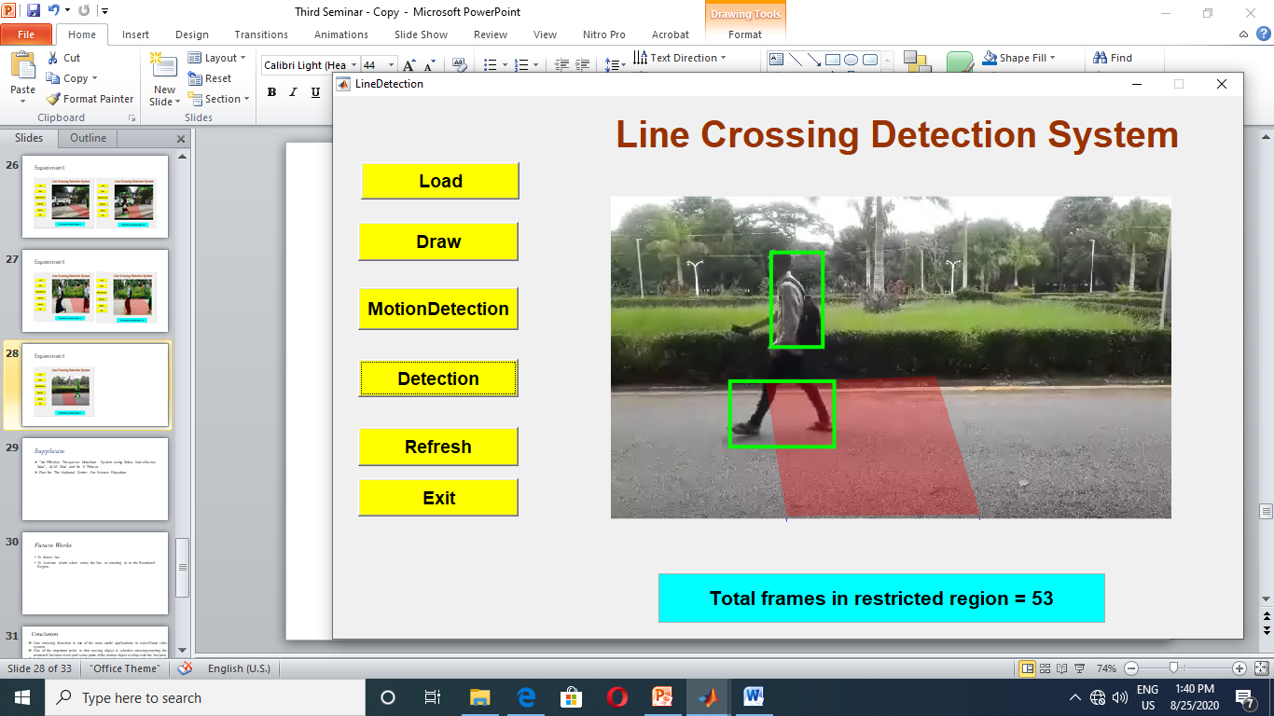
Experiment (Cont;)

Slide 27
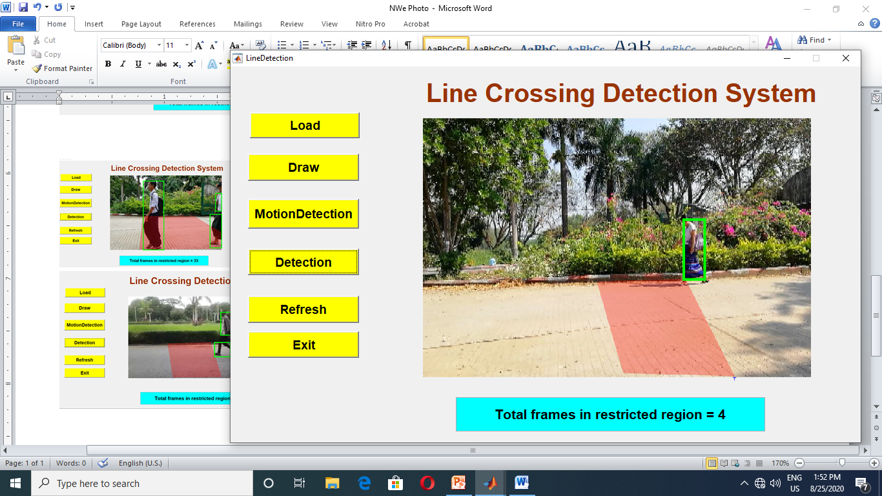
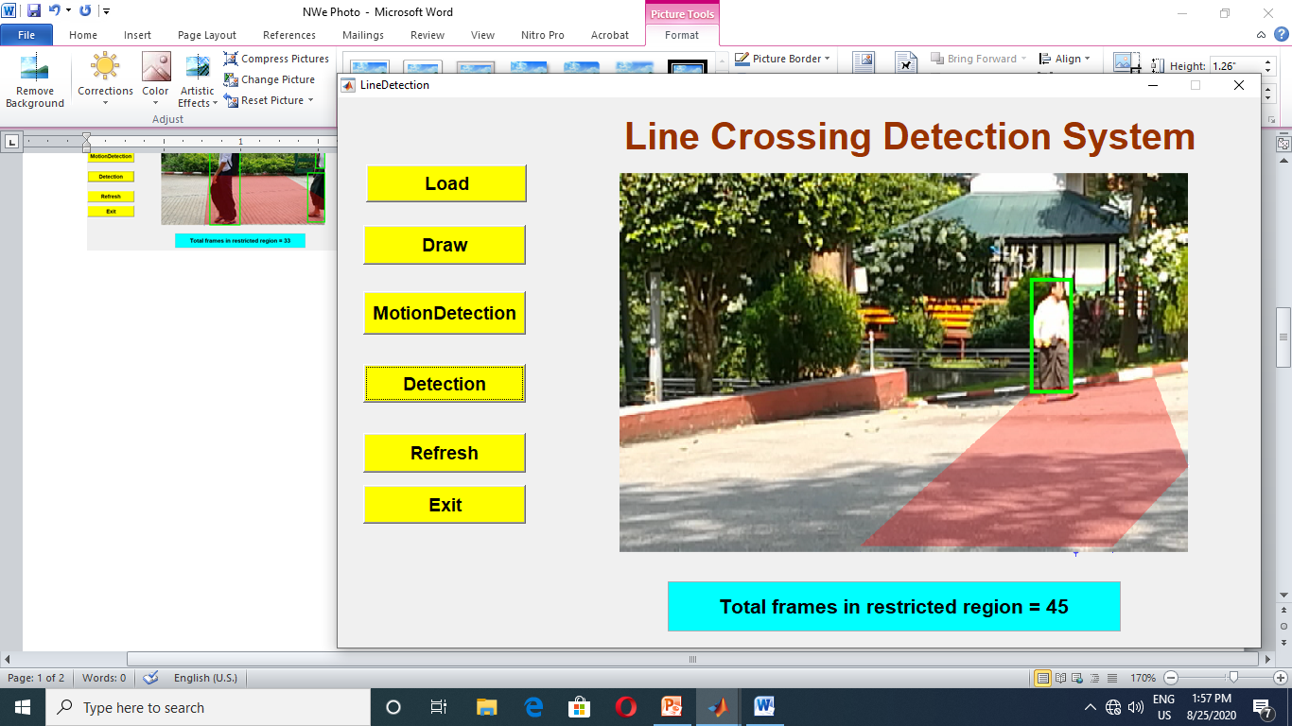
Experiment (Cont;)

Slide 28
Evolution
Accuracy =Detected Frame / Actual frame *100
Actual Frame in Restricted Region = End frame Number-Start frame
Accuracy depends on Detected frame.

Slide 29
Evolution (Cont;)
Actual frame = 110
Detected frame = 96
Accuracy = 96/110 *100
= 87.27 %

Slide 30
Supplicate
“An Effective Trespasser Detection System using Video Surveillance Data”, W.M. Chal and Dr. K .Thinzar .
Plan for The National Center For Science Education .

Slide 31
Future Works
To detect line .
To Activate alarm when cross the line or entering in to the Restricted Region.

Slide 32
Conclusion
Line crossing detection is one of the most useful applications in surveillance video system.
One of the important point is that moving object is whether crossing/entering the restricted line/area or not until some parts of the motion object overlap with the line/area.
In this system, focusing the point, base corner is used as motion point and compared with the restricted line/area.
Hence, the system can achieve more precise and solve the above problems of line/area crossing detection.

Slide 33
References
[1] Shivani, “Border Intruder Detection System Using Digital Image Processing Techniques”, Second International Conference On Innovative Trends In Electronics Engineering (ICITEE2), Vol. 20, pp 62-66, November 2016.
[2] T. Takano, K. Ushita and N. Aoyahma, “Intruder Detection System by Image Processing”, Proceedings of IEEE International Carnahan Conference on Security Technology, pp 102-107, August 2002, Albuquerque of USA.
[3] Masahisa, Hitoshi, Kimiharu and Toshio, “Image Processing Method for Intruder Detection around Power Line Towers”, IAPR Workshops on Machine Vision Application, pp 353-358, December 1992, Tokyo.
[4] Muzammil Bashir, Elke A. Rundensteiner and Ramoza Ahsan, “A deep learning approach to trespassing detection using video surveillance data”, Processing of IEEE International Conference on Big Data, pp.3535-3540, May 2019.
[5] Sapana K. Mishra and Kanchan .S Bhagat, “Human Motion Detection and Video Surveillance Using MATLAB”, International Journal of Scientific Engineering and Research (IJSER), Vol. 3, pp 153-157, July 2015.

Slide 34
References
[1] Wai Kit Wong, Zeh Yang Chew, Chu Kiong Loo and Way Soong Lim, “An Effective Trespasser Detection System Using Thermal Camera”, International Conference on Computer Research and Development, pp. 702-707, October 2015.
[2] Grzegorz Szwoch and Piotr Dalka, “Detection of vehicles stopping in restricted zones in video from surveillance cameras”, Conference of Communications in Computer and Information Science, pp. 182-187, March 2019.
[3] https://kittipatkampa.wordpress.com/image-segme-ntation-using-gaussian-mixture-models.
[4] .P. P. Aung and C. C. Myint, “Automatic Human Motion Detection and Tracking in Complex and Dynamic Environment”, International Conference on Science and Technology for Sustainable Development, pp. 375-380, November 2018.

Slide 35
Thank You For Your Attention

